Slide 1
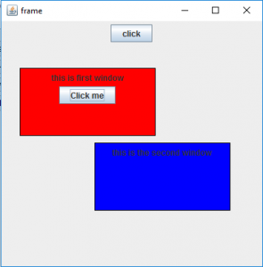
JWindow

Slide 2
JWindow
JWindow()
JWindow(Frame o)
JWindow(Window o)
JWindow(Window o, GraphicsConfiguration g)
JWindow(Window o, GraphicsConfiguration g)

Slide 3
JWindow
setLayout(LayoutManager m)
setContentPane(Container c)
getContentPane()
add(Component c)
isVisible(boolean b)

Slide 4
Referencia:
https://www.geeksforgeeks.org/java-swing-jwindow-examples/
https://docs.oracle.com/javase/7/docs/api/javax/swing/JWindow.html

